Slide 1

Claims Early Warning System
Predicting High-Severity Property Claims
Data Science Capstone
Notes:
Good moring!
Today I’ll present a predictive early warning system designed to identify high-severity property claims early in their lifecycle and reduce overall loss exposure.

Slide 2

Ricky Reyes
BIO:
Property & Casualty insurance industry for 28 years
Texas General Lines Property & Casualty License
Actively pursing my Data Science and AI certification
Notes:
Before we begin, my name Ricky Reyes.
For 28 years, I’ve had the privilege of leading, supporting, and solving problems across the Property and Casualty insurance industry.

Slide 3

What if we could identify which property claims are going to become high-severity before costs escalate?
Notes:
What if we could identify which property claims are going to become high-severity before costs escalate — and intervene early enough to materially reduce the payout?
Today, I’ll walk through a predictive early warning system designed to do exactly that — identify high-risk claims early in their lifecycle and reduce overall loss vol_a_til_ity.

Slide 4
Operational Challenge
10% of claims drive disproportionate loss volatility
Reactive handling increases payout severity
Limited early risk visibility
Notes:
In our portfolio, roughly 10% of claims drive a dis_pro_portion_ate share of total loss vol_a_til_ity.
These severe claims escalate quickly. And in many cases, by the time they are clearly severe, the opportunity to influence outcome has narrowed.
The challenge is not identifying severe claims — it’s identifying them early enough to change the trajectory.

Slide 5

The Strategic Opportunity
• Predict high-risk claims early
• Prioritize proactive intervention
• Reduce loss severity before escalation
Notes:
If we can predict which claims are likely to become severe early in their lifecycle, we can prioritize proactive intervention.
That could mean earlier adjuster engagement, specialized handling, vendor management, or escalation review.
The objective is simple: intervene before severity compounds.

Slide 6

Data and Risk Signals
37,664 claims in evaluation sample
Approximately 10% classified as high-severity
116 categorical and 14 continuous risk indicators
Heavy-tailed loss distribution
Notes:
To evaluate this opportunity, I analyzed over 37,000 claims, with approximately 10% classified as high-severity.
The dataset includes more than 130 structured risk variables — categorical and continuous indicators related to claim characteristics.
Importantly, the loss distribution confirms a heavy-tail pattern. A small percentage of claims generate outsized financial impact.
That makes predictive stratification especially valuable.

Slide 7
Model Evaluation
• Logistic Regression
• Random Forest
• Gradient Boosting
• Evaluated using ROC-AUC, Recall, Precision
ROC-AUC (Receiver Operating Characteristic – Area Under the Curve)
Notes:
I evaluated three modeling approaches:
Logistic Regression, Random Forest, and Gradient Boosting.
Each model was assessed using discrimination metrics — specifically ROC-AUC — and operational detection metrics such as recall and precision.
Given the imbalance in the data, accuracy was not used as a primary decision metric.

Slide 8
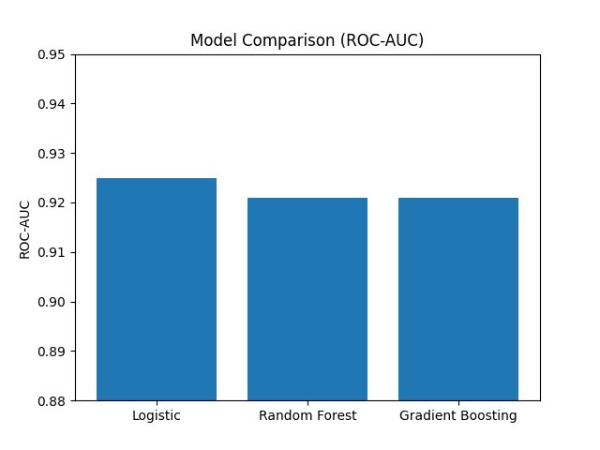
Model Performance Comparison
ROC-AUC (Receiver Operating Characteristic – Area Under the Curve)
Notes:
Logistic Regression achieved the highest ROC-AUC at 0.925.
Both ensemble models performed well but did not meaningfully outperform the logistic model.
In addition, Logistic Regression demonstrated stronger severe-claim detection performance and offers interpretability — which is critical for operational adoption.
Based on performance and practicality, Logistic Regression was selected.

Slide 9
Threshold Optimization
Logistic Regression achieved highest ROC-AUC (0.925)
Higher recall than ensemble models
Selected for interpretability and performance
Notes:
The model performance alone is only part of the story.
The key operational lever is threshold selection — determining how aggressively we classify claims as high risk.

Slide 10
Optimizing Detection
• Default recall: 45% of severe claims detected
• Tuned threshold recall: 62%
• ~643 additional severe claims identified (test sample)
Notes:
At the default threshold, the model detects about 45% of severe claims.
By adjusting the threshold strategically, detection increases to 62%.
That represents 643 additional severe claims identified in this evaluation sample alone.

Slide 11
Operational Impact
• Over 643 additional severe claims identified
• Controlled precision trade- off
• Adjustable based on handling capacity
Notes:
This system is configurable.
Leadership can calibrate the threshold based on operational capacity and appetite for risk detection.
Lower thresholds increase detection but expand workload.
Higher thresholds reduce workload but may miss severe claims.
This flexibility turns the model into a controllable risk management lever rather than a fixed decision engine.

Slide 12
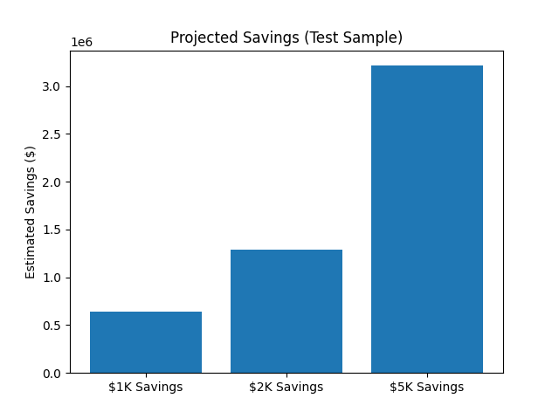
Projected Financial Impact
If intervention reduces severe claims by:
– $1,000 per claim → ~$6.4M annual impact (scaled)
– $2,000 per claim → ~$12.8M
– $5,000 per claim → ~$32M
Notes:
The financial implications are meaningful.
If early intervention reduces severe claim severity by just $1,000 per claim, the scaled annual impact is approximately $6.4 million.
At $2,000 per claim, impact exceeds $12 million.
At $5,000 per claim, the impact exceeds $30 million annually.
These estimates assume modest intervention effectiveness — not transformational change.
The opportunity is material.

Slide 13

Recommendation
• Deploy Logistic Early Warning Model
• Implement threshold-based triage
• Track recall, precision, and severity reduction
• Scalable across claim portfolio
Notes:
I recommend deploying the Logistic Early Warning Model with a threshold calibrated to operational capacity.
The system should be implemented through a triage workflow and monitored using recall, precision, and severity reduction.
This approach shifts claims handling from reactive to predictive — improving risk visibility, reducing loss vol_a_til_ity, and creating measurable financial impact.
The question is not whether we can predict severe claims —
It’s whether we are willing to act on the insight early enough to reduce the loss.

Slide 14

Thank you
Questions?

